Slide 1
Shield of Faith

Slide 2
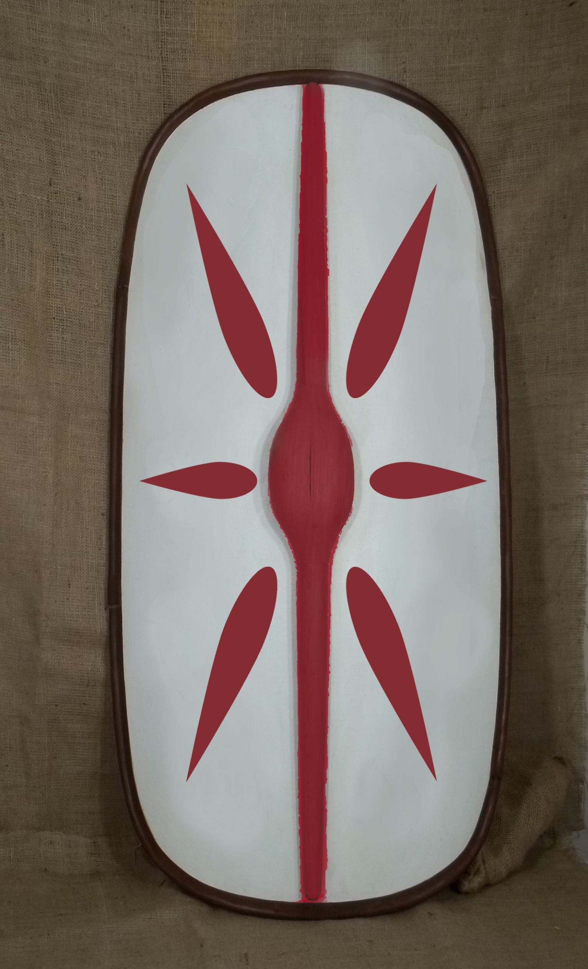
Scutum

Slide 3
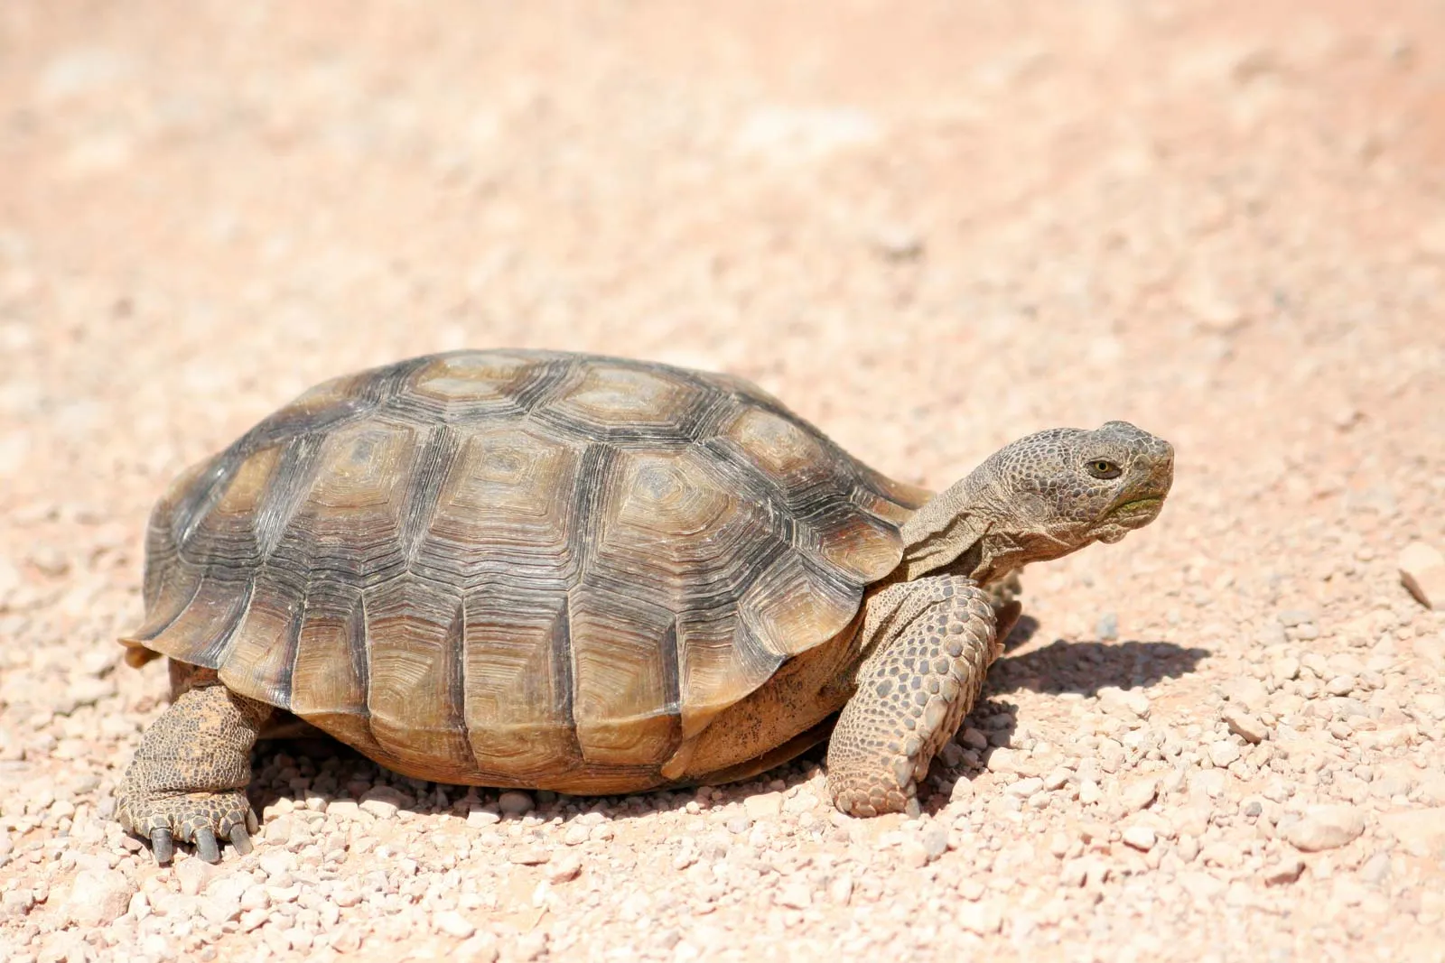
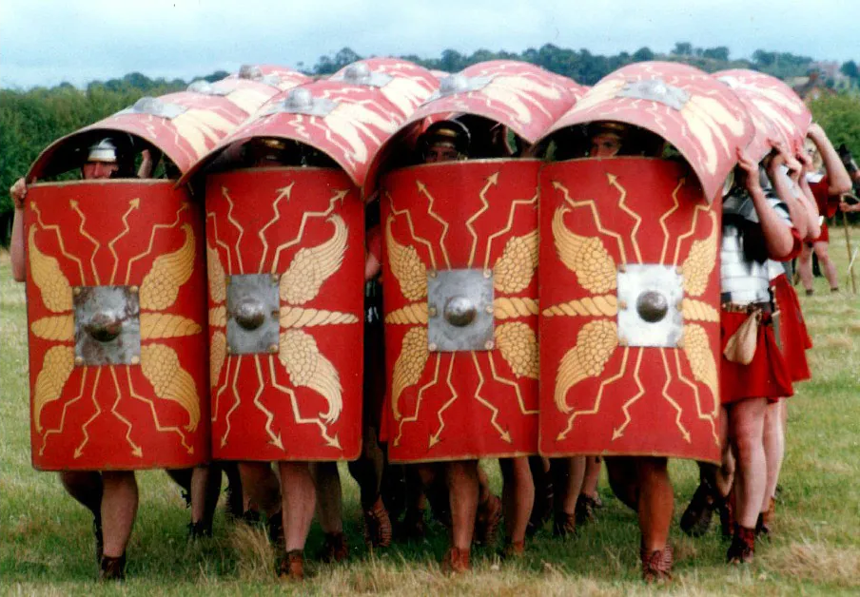
Testudo

Slide 4
Safe
Heart
Integrity
Every day
Lift it up
Dalek

